Slide 1

Cyclist Bike Share Analysis - Presentation

Slide 2
Transform data
Format or Change data type or Transform of raw data.
If needed add Helper column or new column to calculate functions.
Import data
Use import option to import raw data excel into Tableau
Analyse the raw data and getting understand the fields
Save and close the raw data excel.
Confirm the all column's datatypes are updated appropriately ( Ex. Date-Date format, Numbers – Number format, Amount - Accounting format/Currency format.
Tableau
Good to Start create an interactive dashboard based on requirement.

Slide 3
Problem Statement
*Future success depends on maximizing the number of annual members.
Therefore, understand how casual riders and annual members use Cyclistic bikes differently
Analyzed the data in multiple angles and understand how the raw data is available like Rideable type, Member type, Started at, etc.,
Tableau Report is helps to given a solution to improve the business and if incase any mistakes or wrong moves or crossed that is also identified.

Slide 4
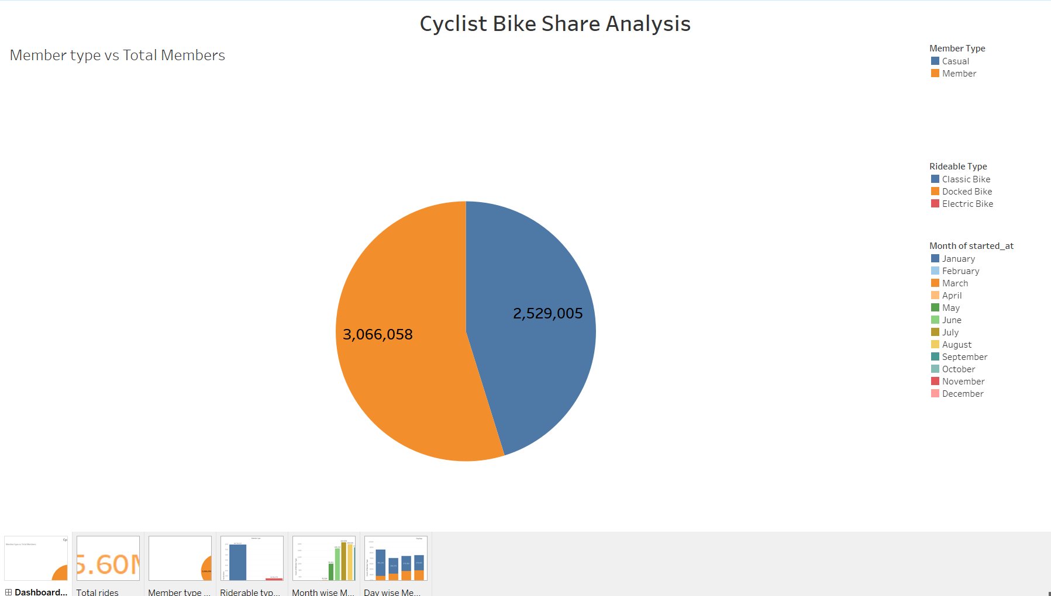
I Have Prepared the below dashboard in tabaleu

Slide 5
My Suggestions
Marketing effort on the top 5 most popular stations for the casual riders.
Promoting offers for Casual riders to join in membership make some % discounts on membership.
Implementing rewards system based on every trip. It may curious and improve the customer mentality to participate more rides.
Providing accessories for riders with an discount price like helmet's, Water bottle, etc., This way impress the riders to join more events.

Slide 6
Thank you !

